Slide 1
IP ADDRESSING

Slide 2
IP address
An IP address (in the case of v4) is built upon 32-bits, expressed in four numbers known as octets. Each octet is 8 bits i.e one byte.
Each IP address has two parts
Network id part - the network the IP address belongs to.
Host id part - the host identifier of the device for the network

Slide 3
Notation
Two representations for IP addresses
Binary Notation
Dotted-Decimal Notation

Slide 4

Notation
Binary Notation: Base 2
In binary notation, an IPv4 address is displayed as 32 bits.

Slide 5
Notation
Dotted-Decimal Notation:
IPv4 address is usually written in decimal form with a decimal point (dot) separating the bytes.
The value of each byte varies from 0 to 255
This format is referred to as dotted-decimal notation

Slide 6
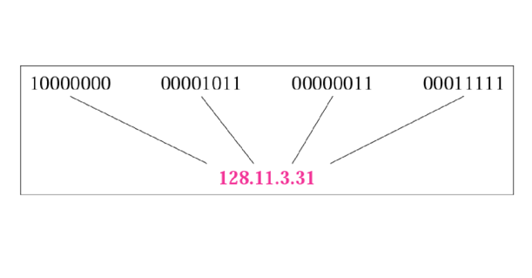
Dotted Decimal Notation

Slide 7
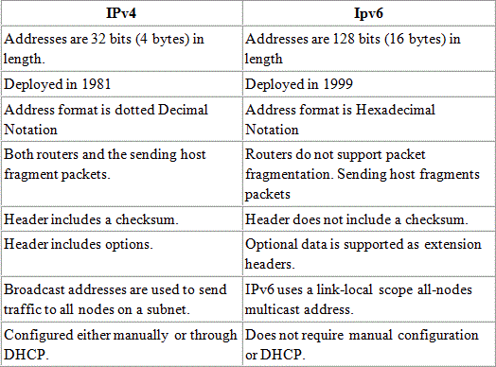
IPV4 and IPV6

Slide 8
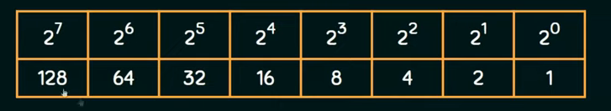

Slide 9
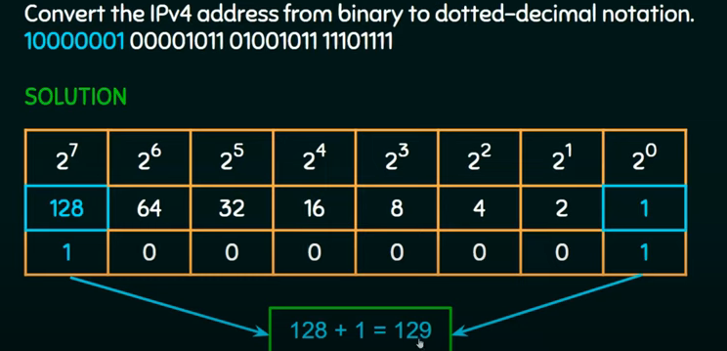

Slide 10
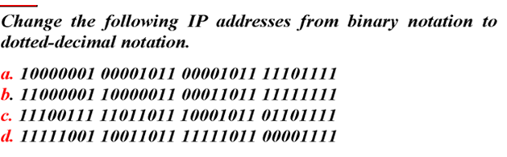
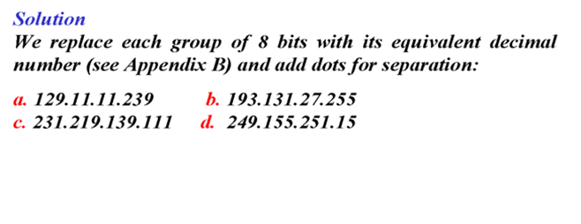

Slide 11
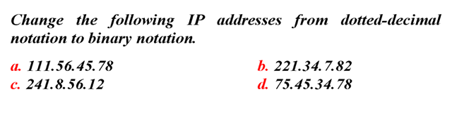
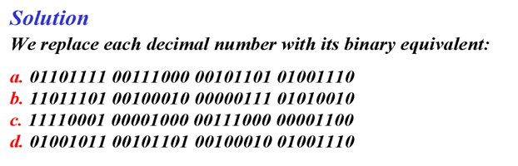

Slide 12
Types of IP addressing schemes
Classful Addressing
Classless Addressing

Slide 13
Classful Addressing
Classful addressing categorizes the IP addresses into five major classes: class A, B, C, D, and E.
The first three classes, Class A, B, and C, are used for "public addressing", in which communication is always one-to-one between source and destination..
The reserved categories include Class D and Class E
Class D being utilized for multicasting.
Class E being saved for future usage exclusively.

Slide 14
Classful Addressing
In IPv4, the Network ID is the first part of Class A, B, and C, while the Host ID is the remaining second portion.
The Host ID always indicates the number of hosts or nodes in a certain network, whereas the Network ID always identifies the network in a specific place.
Classful IP addressing does not provide any flexibility of having less number of Hosts per Network or more Networks per IP Class.

Slide 15
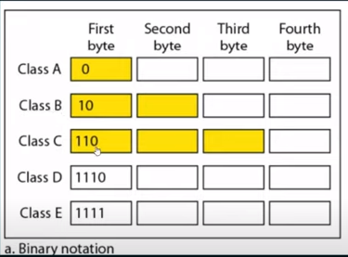
Classes of IPV4 Address-Binary Notation

Slide 16
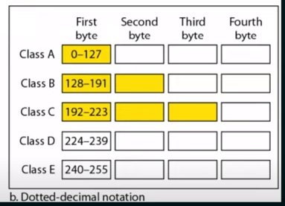
Classes of IPV4 Address-Dotted decimal Notation

Slide 17
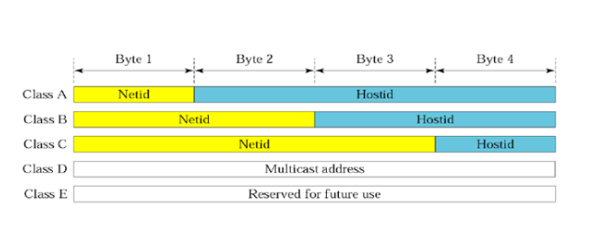
Net id and Host id

Slide 18
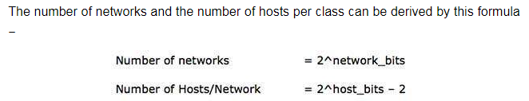
Net id and Host id
When calculating hosts' IP addresses, 2 IP addresses are decreased because they cannot be assigned to hosts,
i.e. the first IP of a network is network number and the last IP is reserved for Broadcast IP.

Slide 19
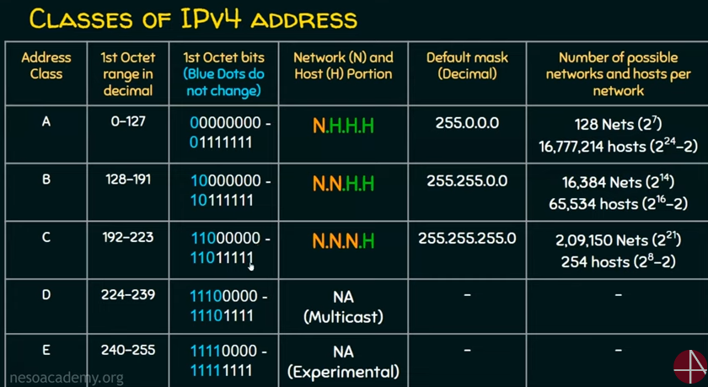

Slide 20
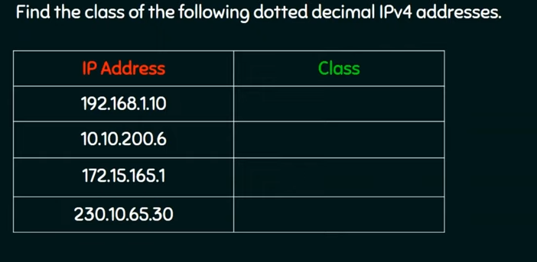

Slide 21
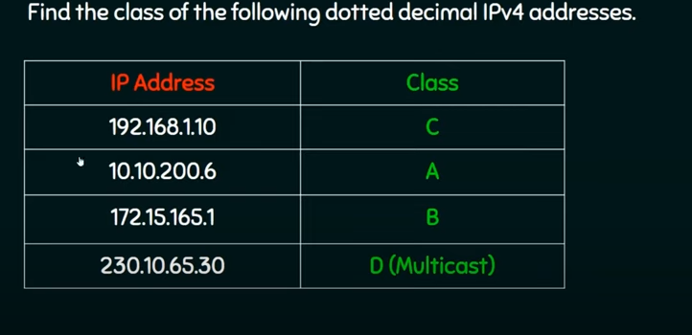

Slide 22
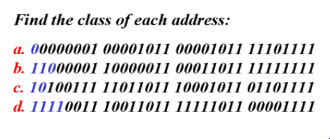

Slide 23
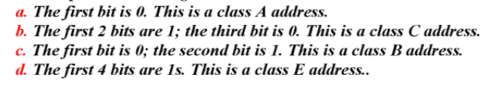
Solution

Slide 24
Subnets
Subnetting is a process of dividing a single network into multiple sub networks.
The number of sub networks created depends upon the requirements.
Subnetting allows a business to expand its network without requiring a new network number from its Internet service provider.
Subnetting helps to reduce the network traffic and also conceals network complexity

Slide 25
Examples of Subnetting
To understand subnetting better let's look at a simple scenario.
A college has four departments: Information Technology, Computer Science, Mechanical, and Civil.
There are 50 students in each department.
The institution used a private class C IP network(with network ID 192.168.1.0).
All computers will work in a single huge network if there is no subnetting.
It becomes complex for the institution admin to handle the task because if he broadcasts some message to the system, it will forward to all the departments.
To solve this type of problem, we use subnetting.

Slide 26
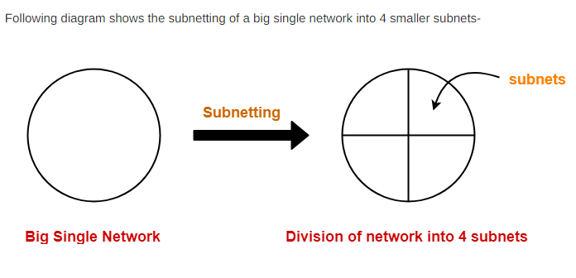

Slide 27
Subnet ID-
Each subnet has its unique network address known as its Subnet ID.
The subnet ID is created by borrowing some bits from the Host ID part of the IP Address.
The number of bits borrowed depends on the number of subnets created.

Slide 28
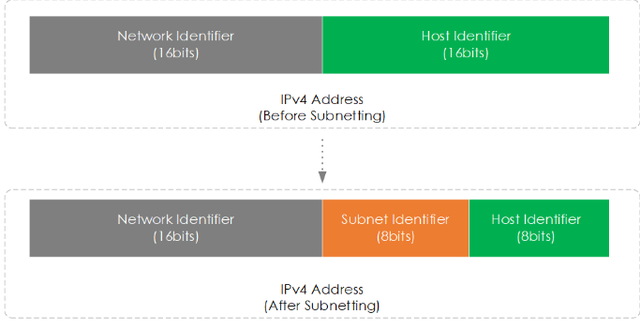
Subnetting
Subnetting works by taking bits from the host part of an IP address in order to create subnet identifier bits .
We then use these subnet bits to calculate the number of additional subnets available.

Slide 29
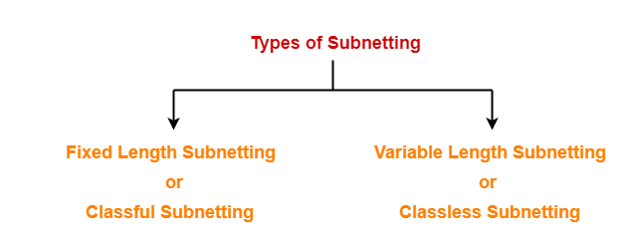
Types of Subnetting-

Slide 30
1. Fixed Length Subnetting-
Fixed length subnetting also called as classful subnetting divides the network into subnets where-
All the subnets are of same size.
All the subnets have equal number of hosts.
All the subnets have same subnet mask.

Slide 31
2. Variable Length Subnetting-
Variable length subnetting also called as classless subnetting divides the network into subnets where-
All the subnets are not of same size.
All the subnets do not have equal number of hosts.
All the subnets do not have same subnet mask.

Slide 32
Characteristics of Subnetting
To design a subnetwork, some features are required to be understood properly which are:
Network ID: It is the first IP address in each Sub-Network in the main network ID.
Broadcast ID: This feature represents the last IP address in each Sub-Network in the network ID.
First Host ID: The next IP address after the Network ID is represented by the First Host ID.
Last Host ID: The IP address right before the Broadcast ID is represented as Last Host ID.

Slide 33
Advantages of Subnetting
Reduce Network traffic
Simplified management
Better Security
Smaller collision and broadcast domain
We can subnet a single large network into smaller networks via subnetting. It is simple to handle small networks.
Subnetting enhances the network's overall performance by removing redundant traffic.

Slide 34
Subnet Mask
The 32-bit IP address contains information about the host and its network.
It is very necessary to distinguish network and host id part of IP address.
For this, routers use Subnet Mask, which is as long as the size of the network address in the IP address.
Subnet Mask is also 32 bits long.
If the IP address in binary is AND ed with its Subnet Mask, the result yields the Network address.

Slide 35
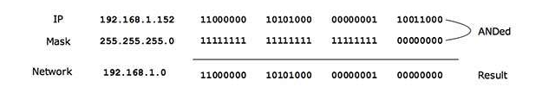
Subnet Mask
For example, say the IP Address is 192.168.1.152 and the Subnet Mask is 255.255.255.0 then −
This way the Subnet Mask helps extract the Network ID and the Host from an IP Address.
It can be identified now that 192.168.1.0 is the Network number and 192.168.1.152 is the host on that network.

Slide 36
Subnet Masks
Every host on a network has subnet mask and IP address.
A subnet mask is a 32-bit binary string of 1’s followed by some numbers of 0’s.
It is used to identify the network and host portion of the IP address.
The subnet mask is made by setting network address bits to all 1s (11111111=255) and host address bits to all 0s (00000000=0)
In any Network, two address is reserved for a special purpose, and cannot be assigned to the hosts. All 0s (0.0.0.0) are assigned to a network address and all "255" (255.255.255.255) are assigned to a broadcast address.
The default subnet mask of class A, B, and C cannot be changed.

Slide 37
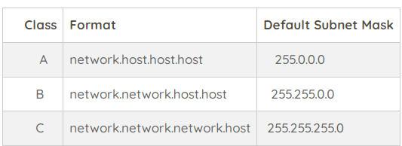
Default subnet mask

Slide 38
More details on subnetting at
https://www.gatevidyalay.com/subnetting-ip-subnetting-examples/

Slide 39
Question
You have been allocated a class C network address of 211.1.1.0 and are using the default subnet mask of 255.255.255.0 how many hosts can you have?

Slide 40
Question
You have been allocated a class C network address of 211.1.1.0 and are using the default subnet mask of 255.255.255.0 how many hosts can you have?
A class C address has 8 bits of the host which will give 2⁸ -2 =254 hosts

Slide 41
Question
A network on the Internet has a subnet mask of 255.255.240.0. What is the maximum number of hosts it can handle?

Slide 42
Solution
Binary representation of 255.255.240.0 is
11111111. 11111111. 11110000. 00000000
No: of bits in network id =20
No: of bits in host id =12
maximum number of hosts it can handle= 2 ¹²
⁼4096 host addresses exist
Total number of hosts that can be configured =2 ¹²- 2

Slide 43
Question
If the subnet mask 255.255.255.128 belongs to class C, find-
Number of subnets
Number of hosts in each subnet

Slide 44
Solution
Given subnet mask
= 255.255.255.128
= 11111111.11111111.11111111.10000000
Number of Host ID bits = 7
It is given that subnet mask belongs to class C.
So, Number of Net ID bits = 24.
And Number of Subnet ID bits= 1
Thus, Number of subnets = 2¹ = 2
Number of hosts per subnet = 2⁷ – 2 = 126

Slide 45
Question
You currently use the default mask for your IP network 192.168.1.0. You need to subnet your network so that you have 30 additional networks, and 4 hosts per network. Is this possible, and what subnet mask should you use?

Slide 46
Solution
Yes it is possible, using subnet mask 255.255.255.248

Slide 47
Question
You still are using the default mask for your IP network 192.168.1.0. You need to subnet your network so that you have 5 additional networks, and 60 hosts per network. Is this possible, and what subnet mask should you use?

Slide 48
Solution
No, it is not possible.

Slide 49
Question
You have sub-netted your class C network 192.168.1.0 with a subnet mask of 255.255.255.240. Please list the following:
number of networks
number of hosts per network
the full range of the first three networks
and the usable address range from those first three networks.

Slide 50
Solution
Number of networks = 16
Number of hosts = 14
Full Range for first three networks:
192.168.1.0-192.168.1.0.15
192.168.1.16-192.168.1.31
192.168.1.32-192.168.1.47
Usable Range for first three networks:
192.168.1.1- 192.168.1.14
192.168.1.17-192.168.1.30
192.168.1.33-192.168.1.46

Slide 51
Question
You have sub-netted your class C network 200.138.1.0 with a subnet mask of 255.255.255.252. Please list the following: number of networks, number of hosts per network, the full range of the first three networks, and the usable address range from those first three networks. Additionally, identify the broadcast addresses for each network

Slide 52
Solution
Number of networks = 64
Number of hosts = 2
Full Range for first three networks:
200.138.1.0- 200.138.1.3
200.138.1.4- 200.138.1.7
200.138.1.8- 200.138.1.11
Usable Range for first three networks:
200.138.1.1-200.138.1.2
200.138.1.5-200.138.1.6
200.138.1.9-200.138.1.10
Broadcast Addresses for first three networks: 200.138.1.3 ,200.138.1.7, 200.138.1.11

Slide 53
Question
Class C mask of 255.255.255.192.
How many subnet bits are used in this mask?
How many host bits are available per subnet?
What are the subnet addresses?
What is the broadcast address of each subnet?
What is the valid host range of each subnet?

Slide 54
To answer question three, use the formula 256-subnetmask to get the first subnet and your variable. Keep adding this number to itself until you get to the subnet mask value to determine the valid subnets. Once you verify all of the subnets, you can determine the broadcast address by looking at the next subnet’s value. The broadcast address is the number just before the next subnet number. Once you have the subnet number and broadcast address, the valid hosts are the numbers in between.
Here are the answers using 255.255.255.192:
How many subnet bits are used in this mask? Answer: 2 2^2-2=2 subnets
How many host bits are available per subnet? Answer: 6 2^6-2=62 hosts per subnet
What are the subnet addresses?Answer: 256-192=64 (the first subnet)64+64=128 (the second subnet)64+128=192. However, although 192 is the subnet mask value, it’s not a valid subnet. The valid subnets are 64 and 128.
What is the broadcast address of each subnet?Answer: 64 is the first subnet and 128 is the second subnet. The broadcast address is always the number before the next subnet. The broadcast address of the 64 subnet is 127. The broadcast address of the 128 subnet is 191.
What is the valid host range of each subnet? Answer: The valid hosts are the numbers between the subnet number and the mask. For the 64 subnet, the valid host range is 64-126. For the 128 subnet, the valid host range is 129-190.
Let’s do a second example using the Class C mask of 255.255.255.224. Here are the answers:
How many subnet bits are used in this mask?Answer: 3 bits or 2^3-2=6 subnets
How many host bits are available per subnet?Answer: 5 bits or 2^5-2=30 hosts per subnet
What are the subnet addresses?Answer: 256-224 =32, 64, 96, 128, 160 and 192 (Six subnets found by continuing to add 32 to itself.)
What is the broadcast address of each subnet?Answer: The broadcast address for the 32 subnet is 63. The broadcast address for the 64 subnet is 95. The broadcast address for the 96 subnet is 127. The broadcast address for the 160 subnet is 191. The broadcast address for the 192 subnet is 223 (since 224 is the mask).
What is the valid host range of each subnet?Answer: The valid hosts are the numbers in between the subnet and broadcast addresses. For example, the 32 subnet valid hosts are 33-62.

Slide 55
Block size= 256-subnetmask

Slide 56
Question
.Subnet the Class C IP Address 195.1.1.0 So that you have 10 subnets each with a maximum 12 hosts on each subnet. List the Address on host 1 on subnet 0,1,2,3,10

Slide 57
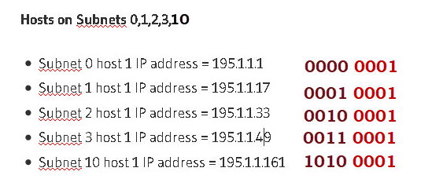
Current mask= 255.255.255.0
Bits needs for 10 subnets =4 =2⁴ =16 possible subnets
Bits needs for 12 hosts = 4 = 2⁴ = 16-2=14 possible hosts.
So our mask in binary =11110000= 240 decimal
Final Mask =255.255.255.240

Slide 58
Question
Subnet the Class C IP Address 205.11.2.0 so that you have 30 subnets.
What is the subnet mask for the maximum number of hosts?
How many hosts can each subnet have?
What is the IP address of host 3 on subnet 2 ?

Slide 59
Current mask= 255.255.255.0
Bits needs for 30 subnets =5 =2⁵ =32 possible subnets
Bits left for hosts = 3 = 2³ = 8-2=6 possible hosts.
So our mask in binary =11111000= 248 decimal
Final Mask =255.255.255.248
Address of host 3 on subnet 2 is
subnet 2 =00010000 host 3 =000000011
Add the two together =00010011=19
therefore IP address of host 3 on subnet 2 =205.11.2.19

Slide 60
Disadvantages of classfull Addressing
If an organization needed more than 254 host machines, it would be switched into Class B.
However, this could potentially waste over 60,000 hosts if the business didn't need to use them, thus unnecessarily decreasing the availability of IPv4 addresses.
The solution to this issue came in the form of - Classless Inter-Domain Routing (CIDR)

Slide 61
Classless Inter-Domain Routing (CIDR) or Classless addressing
It is also called as supernetting.
Classless Inter-Domain Routing (CIDR) is a group of IP addresses that are allocated to the customer when they demand a fixed number of IP addresses.
The group of IP addresses is called Block in Classless Inter - Domain (CIDR).
In CIDR there is no wastage of IP addresses as compared to classful addressing because only the numbers of IP addresses that are demanded by the customer are allocated to the customer.

Slide 62
CIDR Notation
CIDR follows CIDR notation or Slash notation.
The representation of CIDR notation is x.y.z.w /n
x.y.z.w is IP address
n is called mask or number of bits that are used in network id.

Slide 63
CIDR IP addresses
This IP address contains two groups of numbers:
Network prefix (123.45.67.89): The binary configuration of a network address
Suffix (/12): The indication of how many bits are in the entire CIDR address
ie 123.45.67.89 /12
IPv4 addresses are 32-bits long
In the above CIDR Address the first 12 bits represent network addresses, the remaining 20 bits represent the available host addresses. j

Slide 64
The network address is written as a prefix, similar to how an IP address is written (e.g. 192.255.255.255).
The suffix, which means how many bits are in the whole address (e.g. /12), is the second component. A CIDR IP address will look anything like this when put together −
192.255.255.255/12

Slide 65
Classless Inter-Domain Routing (CIDR)
Network part is represented with bit 1 and host part with bit 0
For Example, a subnet mask of 255.255.255.192 can be represented as follows in binary:
11111111.11111111.11111111.11000000
In the above subnet mask, the first 26 bits are set to 1. The CIDR notation for this subnet mask would be /26.

Slide 66
variable-length subnet masking
CIDR is based on variable-length subnet masking (VLSM)
VLSM allows network engineers to divide an IP address space into a hierarchy of subnets of different sizes, making it possible to create subnets with very different host counts without wasting large numbers of addresses

Slide 67
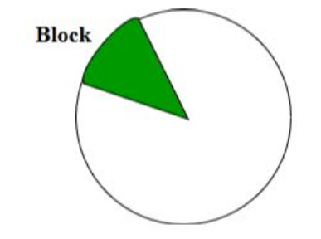
CIDR
IANA is using this technique to provide the IP addresses.
Whenever any user asks for IP addresses, IANA is going to assign that many IP addresses to the User.

Slide 68
IANA
IANA stands for internet assigned numbers authority
all the ip addresses are controlled by this authority
assign the ip addresses to this entire world

Slide 69
Rules for forming CIDR Blocks:/Properties of CIDR Block
All IP addresses must be contiguous.
Block size must be the power of 2 (2^{n}). If the size of the block is the power of 2, then it will be easy to divide the Network. Finding out the Block Id is very easy if the block size is of the power of 2.
First IP address of the Block must be evenly divisible by the size of the block. in simple words, the least significant part should always start with zeroes in Host Id. Since all the least significant bits of Host Id is zero, then we can use it as Block Id part.

Slide 70
Question
You have the following address: 192.16.5.133/29 How many total bits are being used to identify the network, and how many total bits identify the host?

Slide 71
solution
29 bits identify the network, 3 bits identify the host.

Slide 72
Question
What is the full subnet mask for address 172.16.5.10/28?

Slide 73
Question
What is the full subnet mask for address 172.16.5.10/28? 255.255.255.240

Slide 74
Question
In given class c, Address: 192.168.10.0/26, find the following:
How many subnets?
How many hosts per subnet?
What are the valid subnets?
What’s the broadcast address for each subnet?
What is the valid host?

Slide 75
Solution:
As we know, in class C
Network ID = 8
Host ID = 24
Network address = 192.168.10.0
CIDR = 26
Since, 26 ON bits, so the subnet mask will be 255.255.255.192.
In, 192 (11000000) Number of ON bits = 2
Number of OFF bits = 6
No. of subnets = 2²= 4
No. of hosts per subnet = 2⁶-2 = 64-2=62
Valid subnets (Block size) = 256-192 = 64. We start at zero and count in our block size, so our subnets are 0, 64, 128, and 192.
For zero subnet, the next subnet is 64, so the broadcast of 0 subnet is 63.
Valid hosts are the numbers between the subnet and broadcast address.

Slide 76
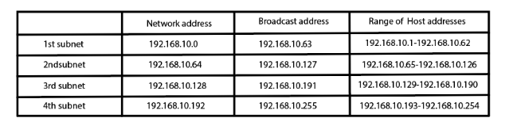

Slide 77
Example: Check whether 100.1.2.32 to 100.1.2.47 is a valid IP address block or not?
All the IP addresses are contiguous.
Total number of IP addresses in the Block = 16 = 2⁴.
1st IP address: 100.1.2.00100000 Since, Host Id will contains last 4 bits and all the least significant 4 bits are zero. Hence, first IP address is evenly divisible by the size of the block.
All the three rules are followed by this Block. Hence, it is a valid IP address block.

Slide 78
More subnetting examples at
http://www.steves-internet-guide.com/subnetting-worked-examples/
https://www.tutorialandexample.com/subnetting

